Slide 1
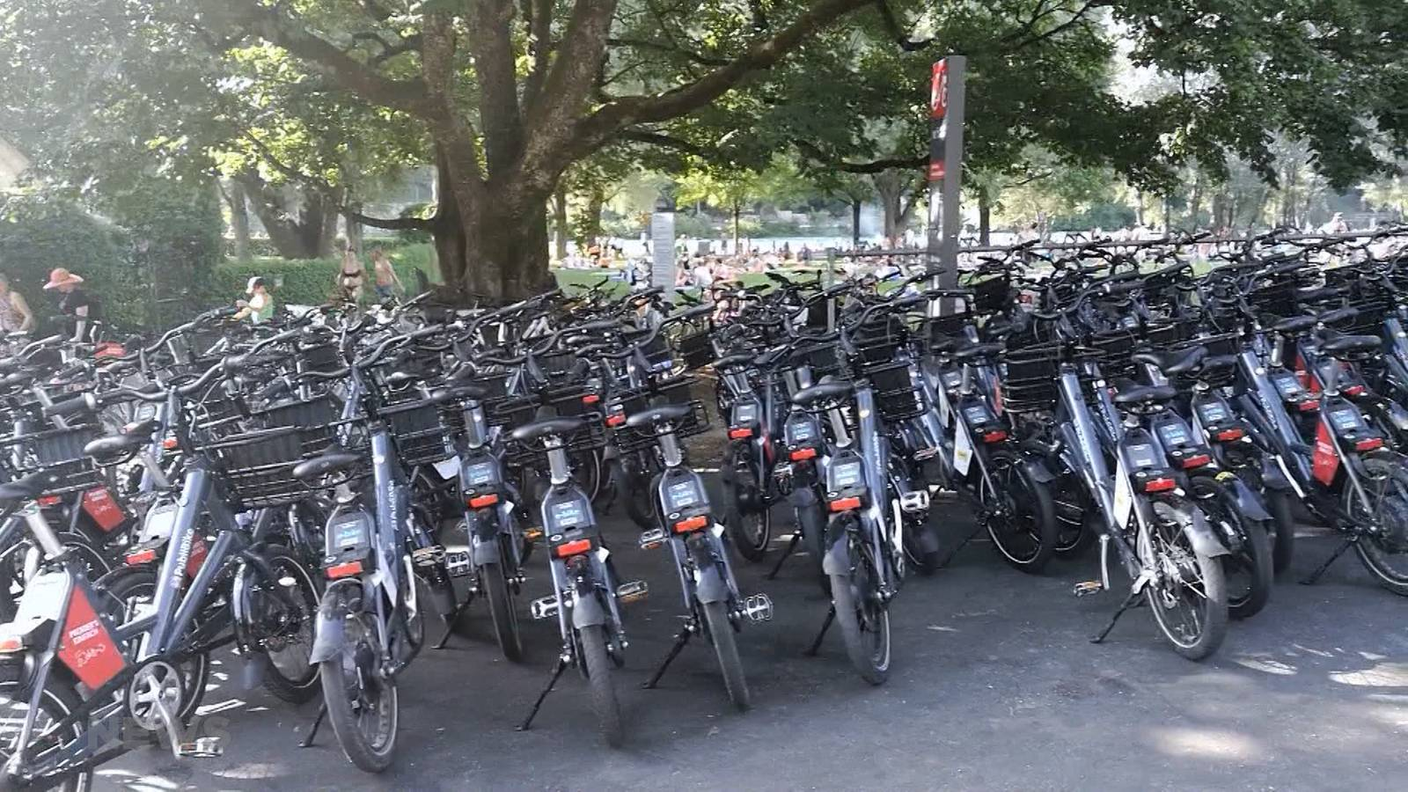
Predicting PubliBike Availability
M3 Project by Marco Sommerfeld & Viktor Kitanov

Slide 2
Introduction
Hot Summer 2023
Popular way to cool down: Marzili & Aare swim
Stay cool after leaving: E-Bike up the hill
By what time to leave to have a chance for an E-Bike?
Project Focus - M3 Project: Predicting E-Bike availability by only focusing on time variable

Slide 3
Data
Hourly PubliBike Availability of all Stations in Bern
Prepare data (creation of weekday, hour of day and continuous time)
Filter data (summer season, station)
Create groups for availability

Slide 4
Models
Linear Regression
Logistic Regression
Decision Trees
Random Forest
Boosted Decision Trees
Neural Network

Slide 5
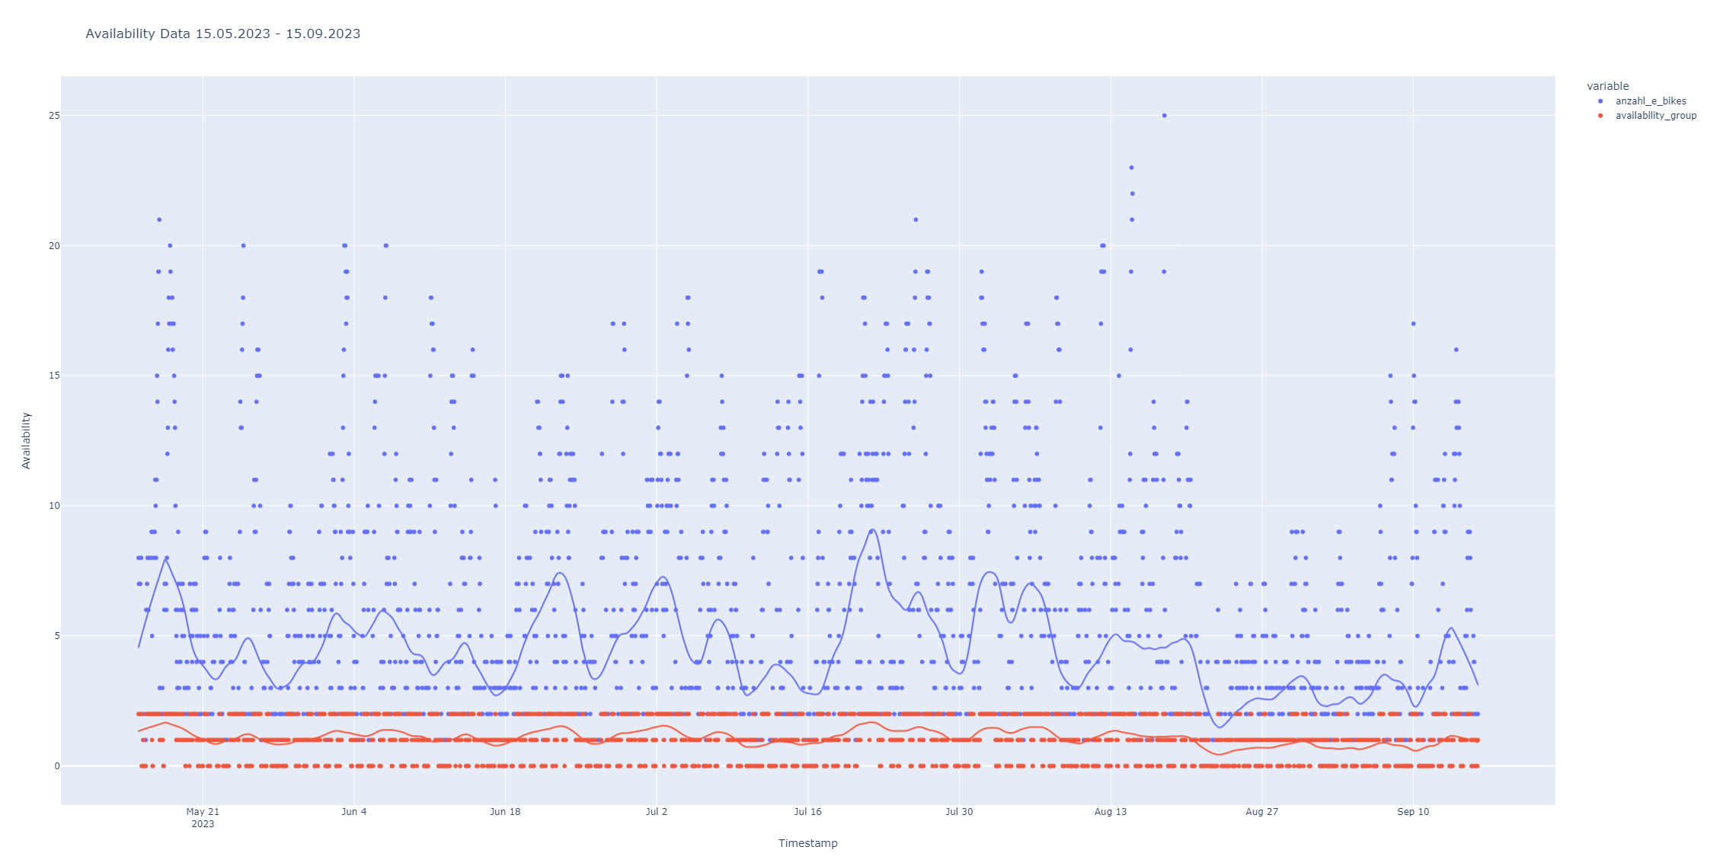
Instead of using a sledgehammer to crack the nut …

Slide 6
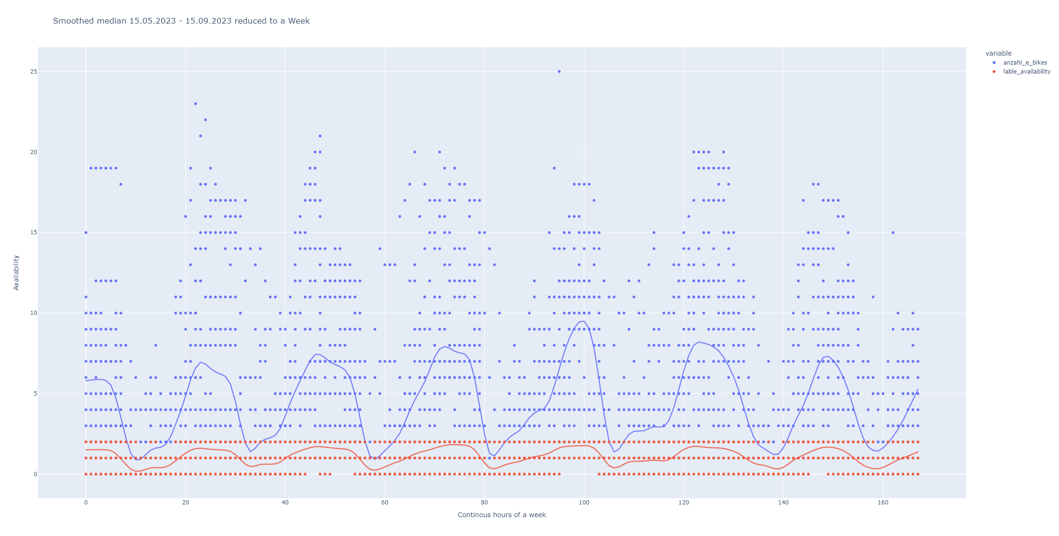
Instead of using a sledgehammer to crack the nut …look at the mean for each hour of a day of the week

Slide 7
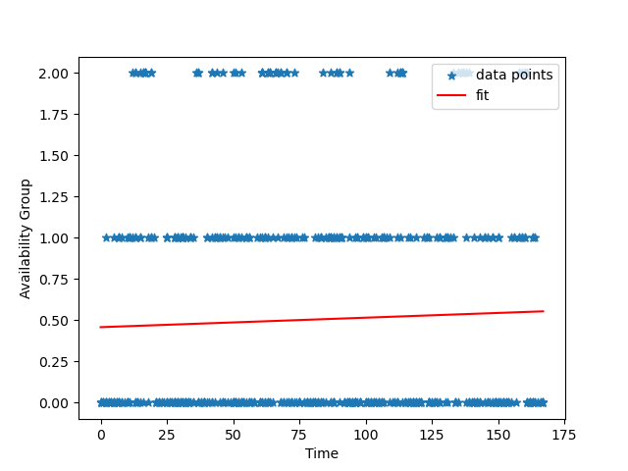
Linear regression
Mean Squared Error: 0.489

Slide 8
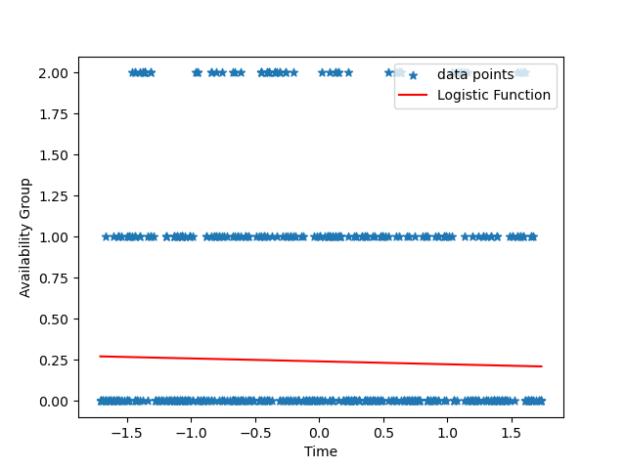
Logistic regression
MSE = 0.744
Accuracy: 0.612
Precision: 0.374
Recall: 0.612
F1-Score: 0.465
Confusion Matrix:
[[361 0 0]
[159 0 0]
[ 70 0 0]]

Slide 9
Decision Trees

Slide 10
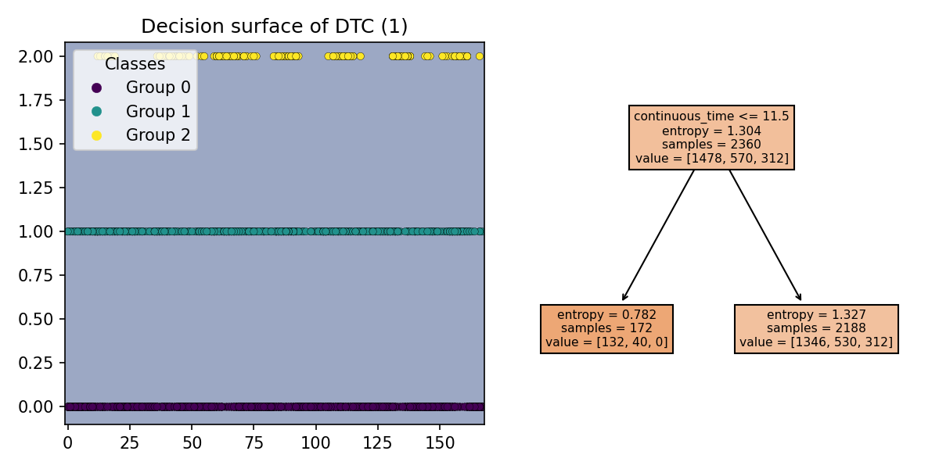
E-Bike Training Score: 0.626, MSE = 0.744, Accuracy: 0.612, Precision: 0.374, Recall: 0.612, F1-Score: 0.465, Confusion Matrix: [[361 0 0] [159 0 0] [ 70 0 0]]

Slide 11
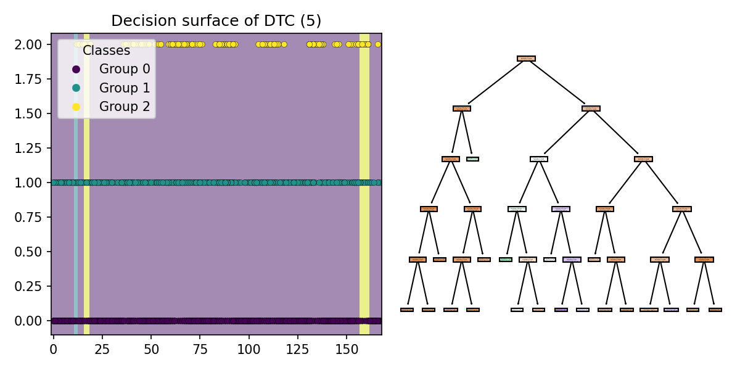
E-Bike Training Score: 0.643, MSE = 0.686, Accuracy: 0.629, Precision: 0.627, Recall: 0.629, F1-Score: 0.517, Confusion Matrix: [[354 1 6] [148 4 7] [ 56 1 13]]

Slide 12
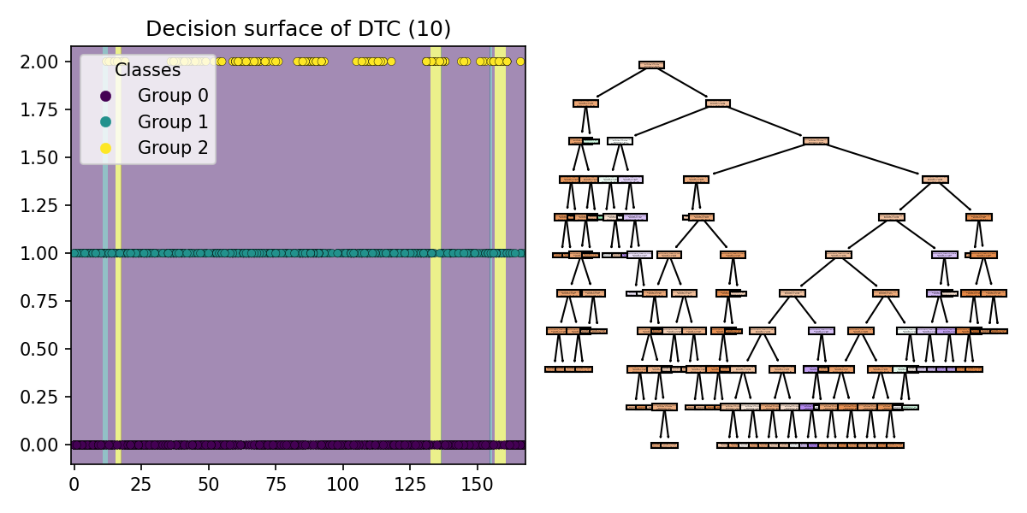
E-Bike Training Score: 0.657, MSE = 0.666, Accuracy: 0.634, Precision: 0.624, Recall: 0.634, F1-Score: 0.527, Confusion Matrix: [[353 2 6] [147 5 7] [ 53 1 16]]

Slide 13
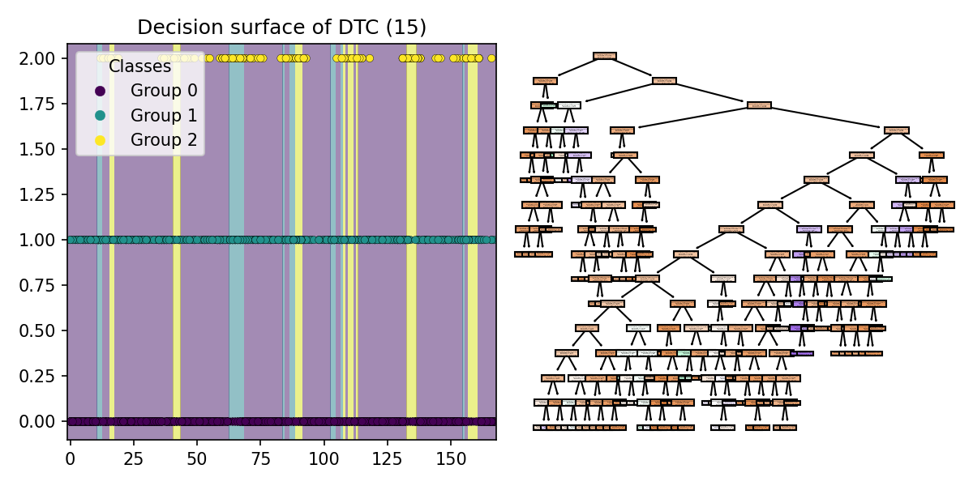
E-Bike Training Score: 0.676, MSE = 0.608, Accuracy: 0.620, Precision: 0.553, Recall: 0.620, F1-Score: 0.564, Confusion Matrix: [[323 24 14] [122 18 19] [ 31 14 25]]

Slide 14
Random Forest

Slide 15
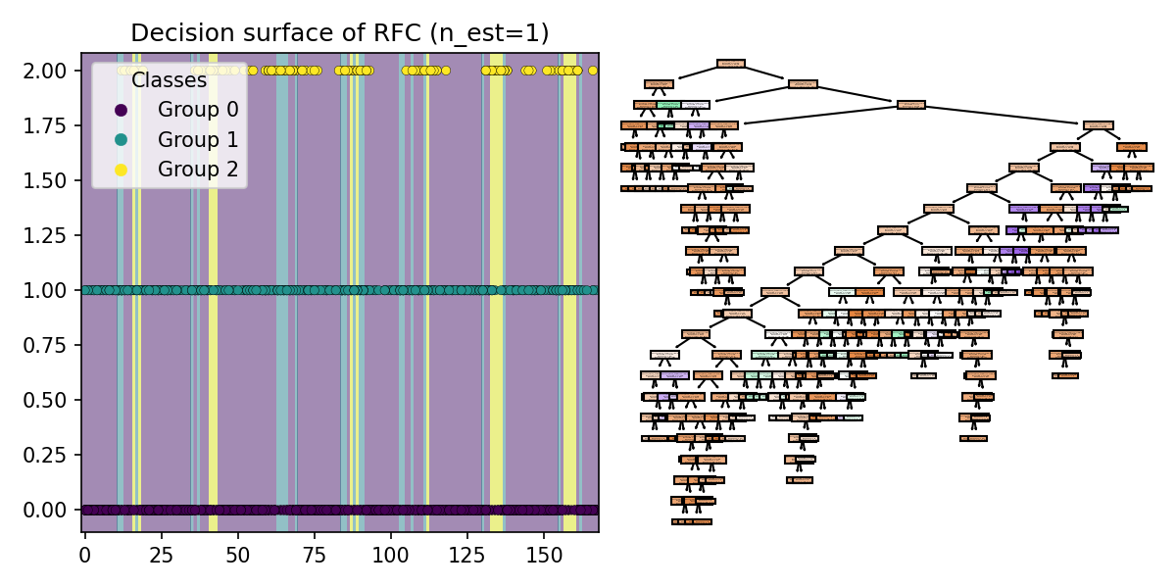
E-Bike Training Score: 0.668, MSE = 0.651, Accuracy: 0.593, Precision: 0.533, Recall: 0.593, F1-Score: 0.549, Confusion Matrix: [[308 37 16] [118 24 17] [ 32 20 18]]

Slide 16

E-Bike Training Score: 0.676, MSE = 0.592, Accuracy: 0.632, Precision: 0.575, Recall: 0.632, F1-Score: 0.581, Confusion Matrix: [[327 19 15] [118 25 16] [ 29 20 21]]

Slide 17
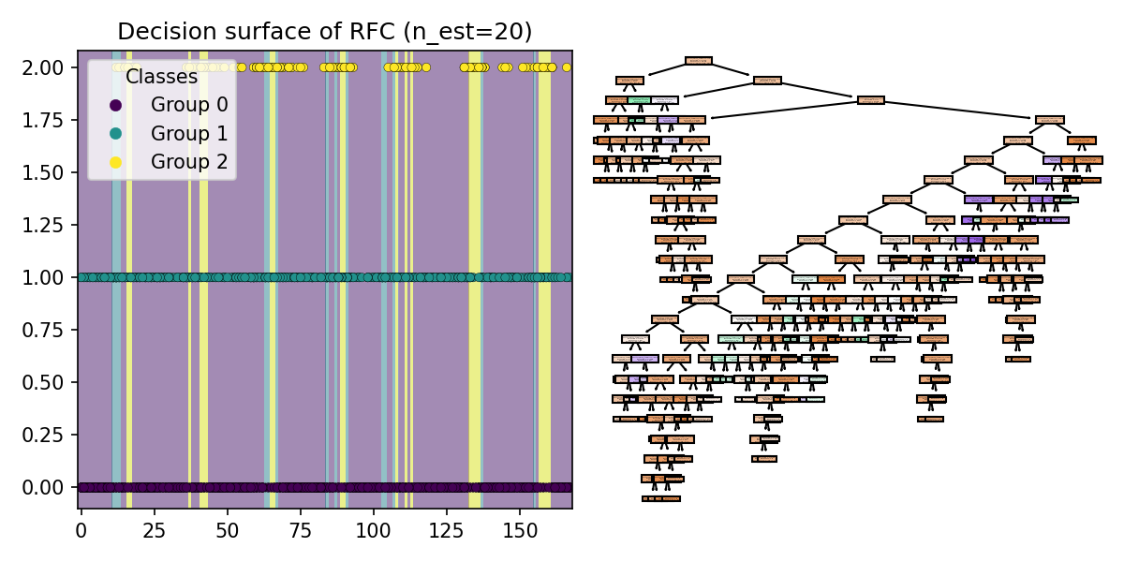
E-Bike Training Score: 0.681, MSE = 0.588, Accuracy: 0.636, Precision: 0.579, Recall: 0.636, F1-Score: 0.581, Confusion Matrix: [[325 19 17] [122 20 17] [ 27 13 30]]

Slide 18
Boosted Decision Trees

Slide 19
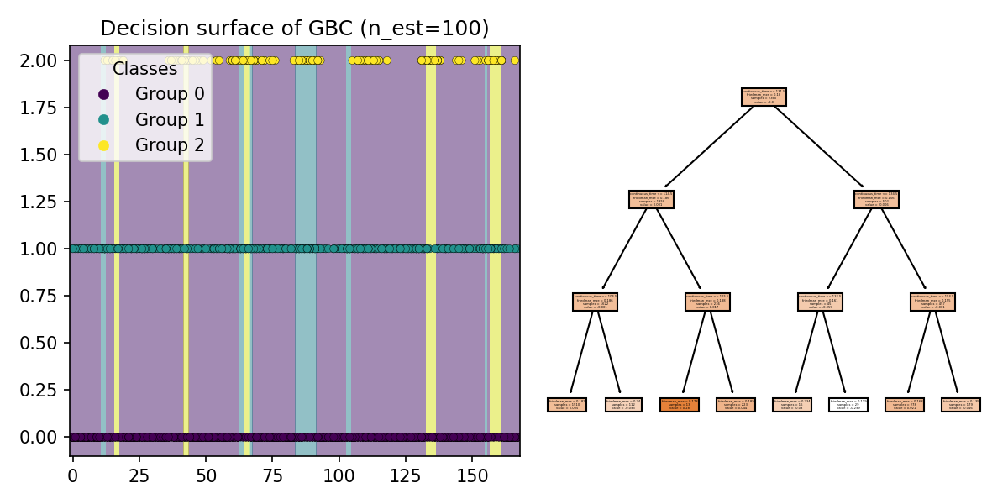
E-Bike Training Score: 0.675, MSE = 0.598, Accuracy: 0.636, Precision: 0.584, Recall: 0.636, F1-Score: 0.580, Confusion Matrix: [[329 22 10] [123 25 11] [ 36 13 21]]

Slide 20
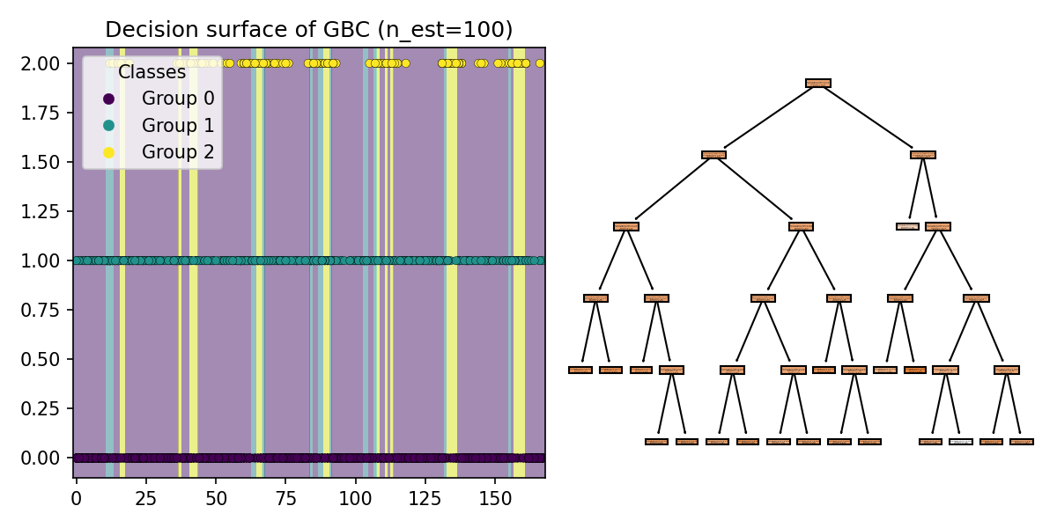
E-Bike Training Score: 0.680, MSE = 0.632, Accuracy: 0.627, Precision: 0.573, Recall: 0.627, F1-Score: 0.571, Confusion Matrix: [[323 21 17] [124 20 15] [ 34 9 27]]

Slide 21
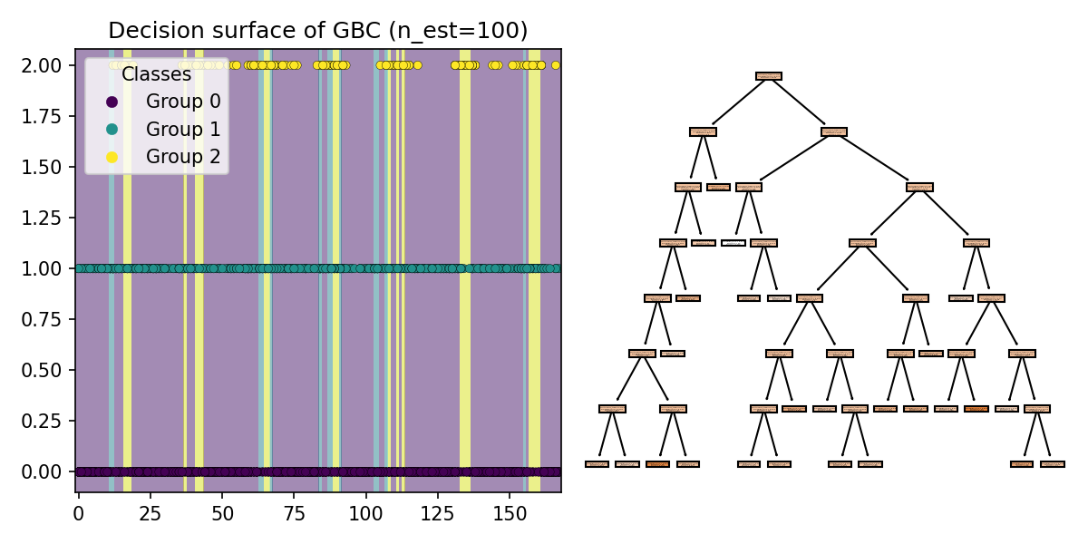
E-Bike Training Score: 0.681, MSE = 0.619, Accuracy: 0.631, Precision: 0.577, Recall: 0.631, F1-Score: 0.576, Confusion Matrix: [[322 21 18] [121 20 18] [ 31 9 30]]

Slide 22
Let’s compare the results
Method | MSE | Training score | Accuracy | Precision | Recall | F1-Score
Linear regression | 0.598 | n/a
Logistic regression | 0.744 | 0.626 | 0.612 | 0.374 | 0.612 | 0.465
Decision Tree, depth: 15 | 0.608 | 0.676 | 0.620 | 0.553 | 0.620 | 0.564
Random Forest, n_est: 20 | 0.588 | 0.681 | 0.636 | 0.579 | 0.636 | 0.581
Boosted Decision Tree | 0.619 | 0.681 | 0.631 | 0.577 | 0.631 | 0.576

Slide 23
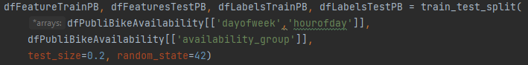
Neural Network Data
Raw Data received
2766401 Datasets. Measured hourly
Number of datasets
2766401 → All Stations 07.07.2022 – 15.11.2023
12030 → Station Gelateria di Berna 07.07.2022 – 15.11.2023
→ Station Gelateria di Berna 15.05-2023 – 15.09.2023
Data structure used for training (Integer!)
Feature name | Example
timestamp | 2022-07-07 15:00:00
Station_id | 230
Available_ebikes | 5
Feature dayofweek | Feature hourofday | Label availability_group
e.g. 6 | e.g. 23 | e.g. 1

Slide 24
Neural Network Process to getting acceptable results
Start with random parameter → Results not usable
Optimizing Input Data (Availability Groups) → Still not usable
model = tf.keras.models.Sequential([ tf.keras.layers.Flatten(input_shape=(2,)), tf.keras.layers.Dense(32, activation='relu'), tf.keras.layers.Dense(6, activation='relu'), tf.keras.layers.Dense(3, activation='softmax'), ]) availability = model.fit(dfFeatureTrainPB, dfLabelsTrainPB, epochs=10, batch_size=50, validation_data=(dfFeaturesTestPB, dfLabelsTestPB))

Slide 25
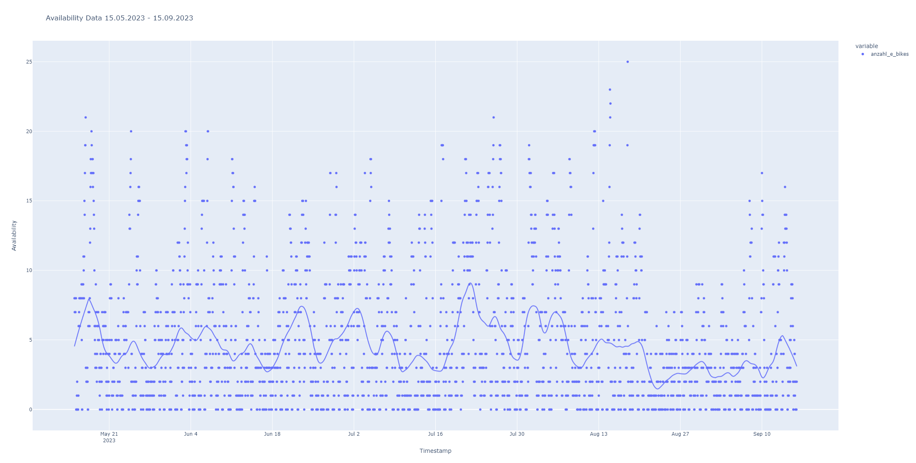
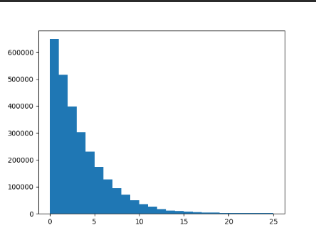
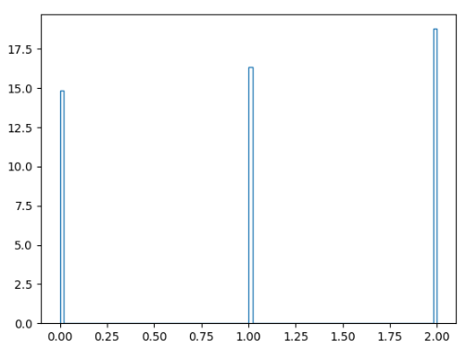
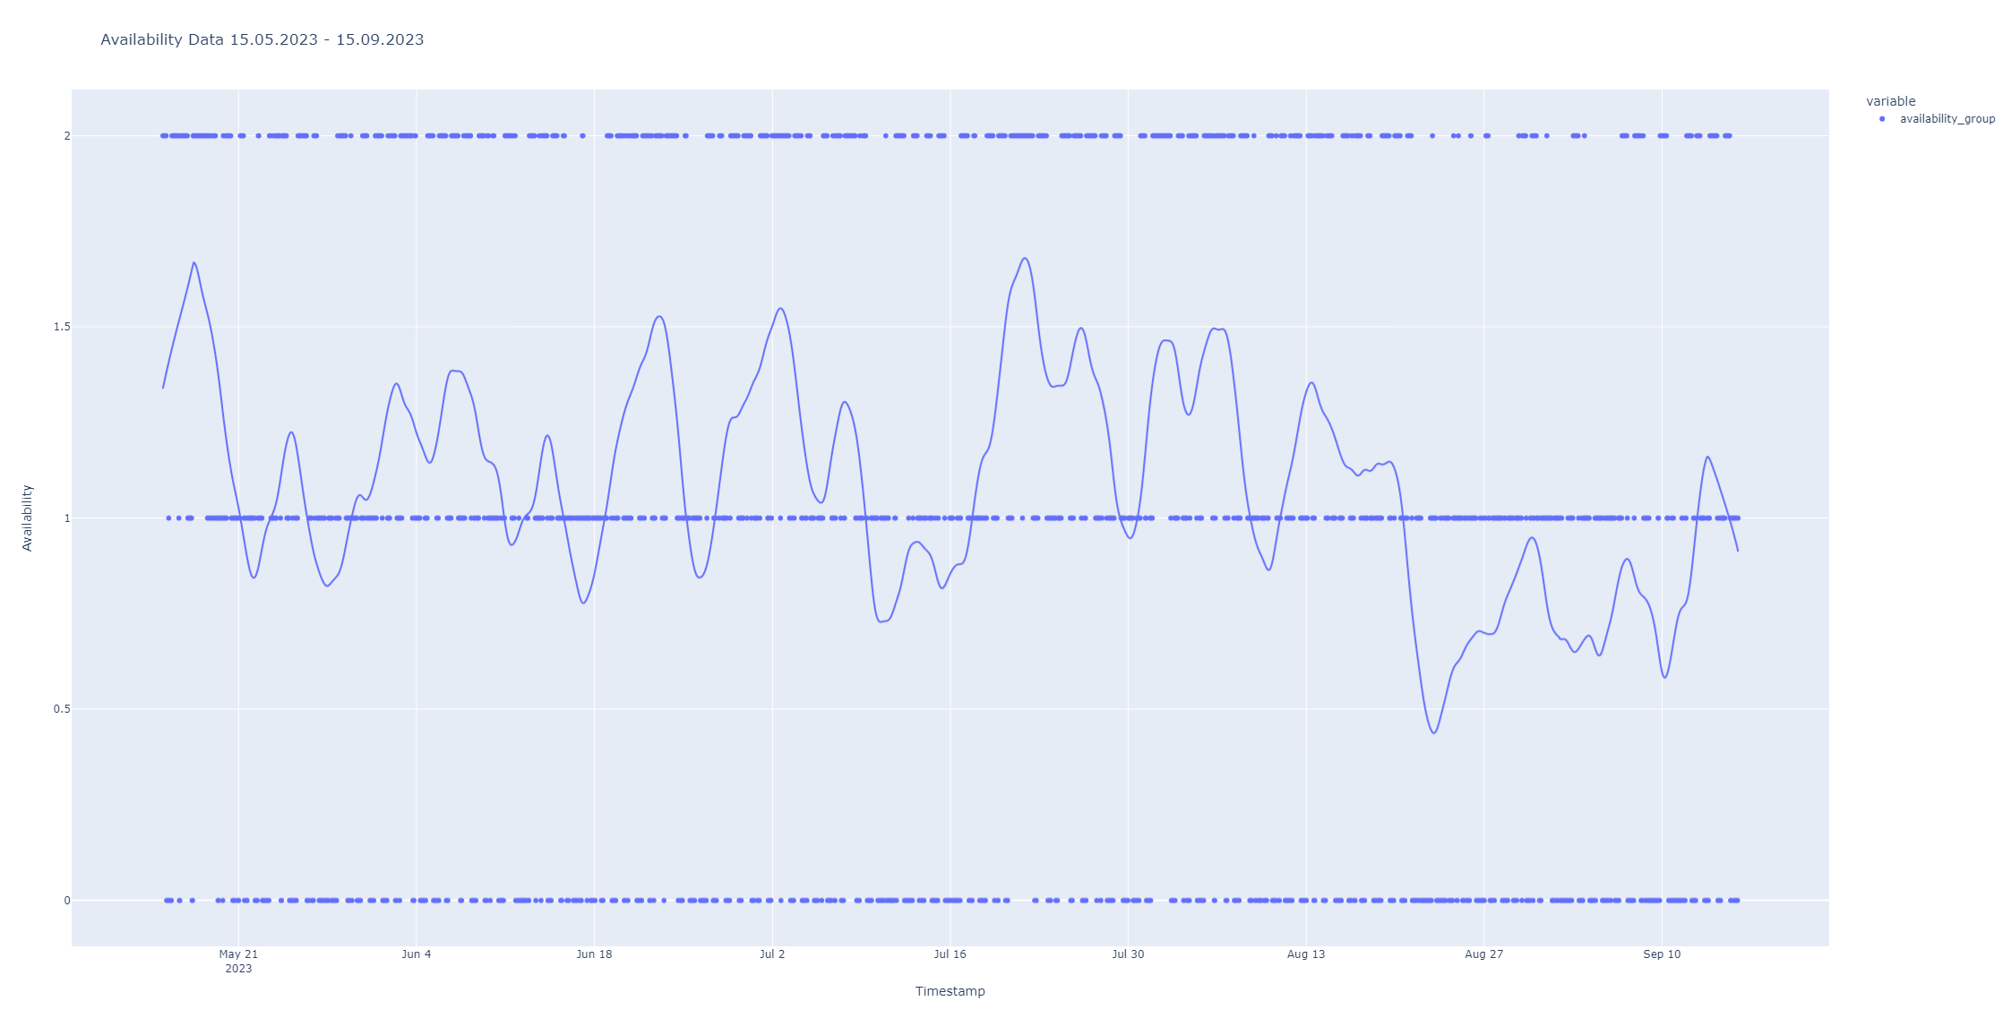
2. Optimizing Input Data
Availability Data 15.05.2023 -15.09.2023 Gelateria di Berna
Histogram Availability Groups
No. of e-bikes available
Frequency
Availability Group
Timestamp
Availability Group Data 15.05.2023 -15.09.2023 Gelateria di Berna
Availability Group
Group 0 = 0 to 1 bike is available
Group 1 = 2 to 4 bikes are available
Group 2 = more than 4 bikes are available
Timestamp

Slide 26
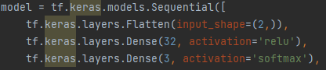
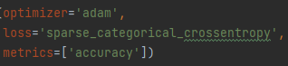
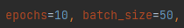
Neural Network Process to getting acceptable results
Start with random parameter → Results not usable
Optimizing Input Data (Availability Groups) → Still not usable
Optimizing Input Data (take just one Season) → getting better
→ 15.05.2023 – 15.09.2023
Optimizing Input Data (Train for just one Station) → getting way better
Playing a lot with parameters

Slide 27

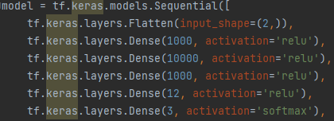
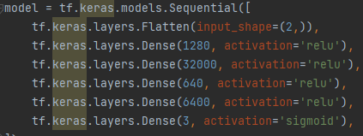
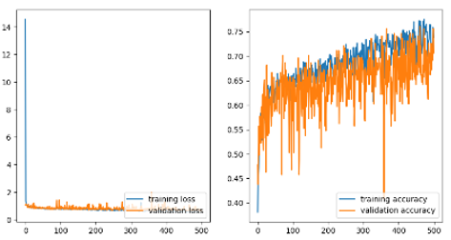
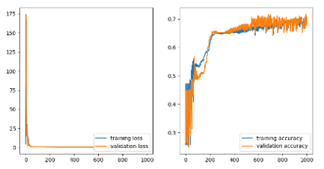
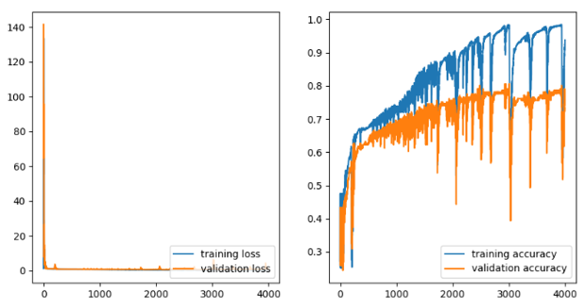
Process to getting acceptable results 5.Playing a lot with parameters

Slide 28
Neural Network Process to getting acceptable results
Start with random parameter → Results not usable
Optimizing Input Data (Availability Groups) → Still not usable
Optimizing Input Data (take just one Season) → getting better
→ 15.05.2023 – 15.09.2023
Optimizing Input Data (Train for just one Station) → getting way better
Playing a lot with parameters
Get a usable result

Slide 29
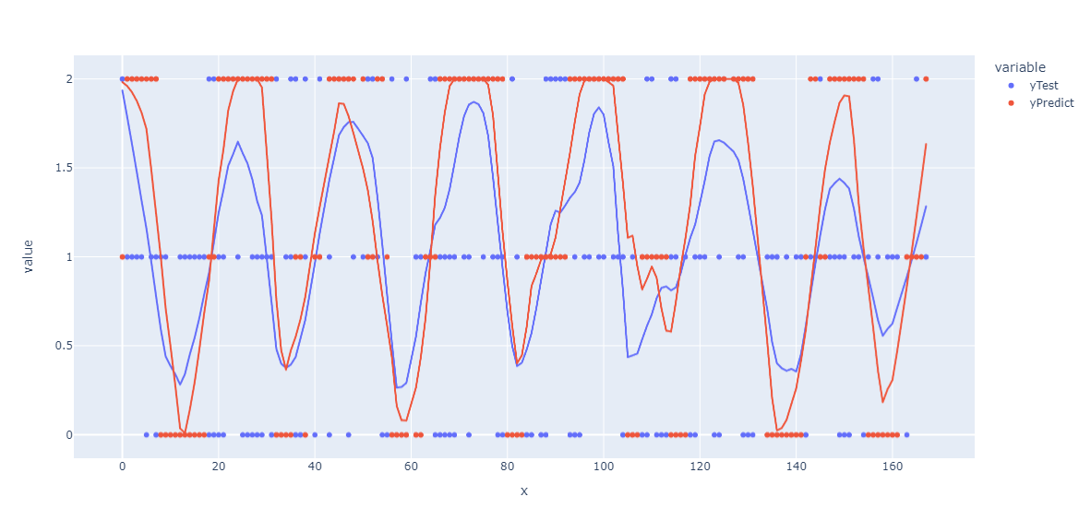
Process to getting acceptable results 6. Get a usable result

Slide 30
Conclusion

Slide 31
Thank you for your attention

Slide 32
Backup

Slide 33
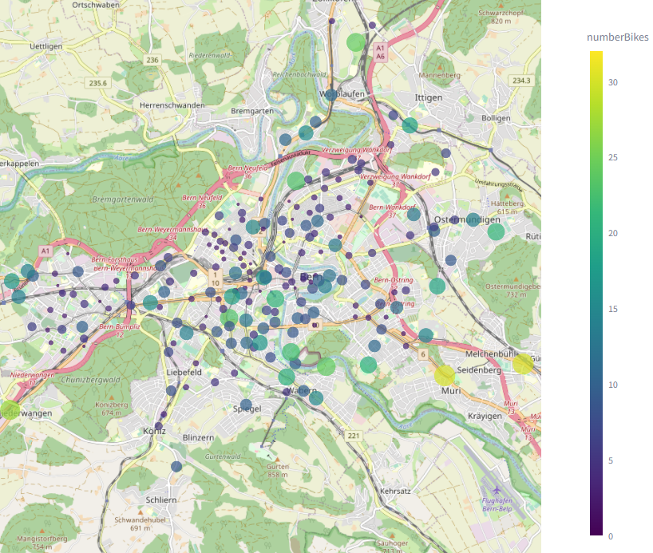
Kontext
Verfügbarkeiten der Publibikes:
Aktuelle Situation: https://flycomp.streamlit.app/PubliBikes

Slide 34
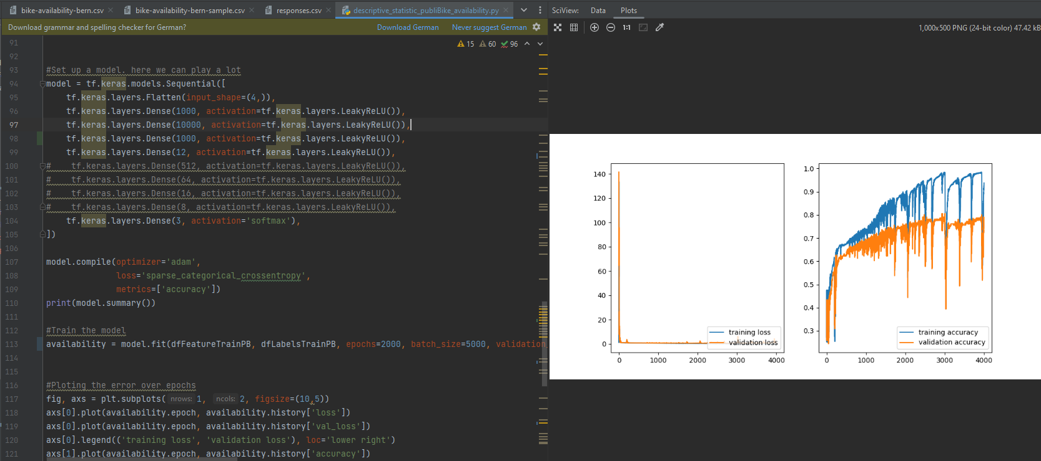

Slide 35
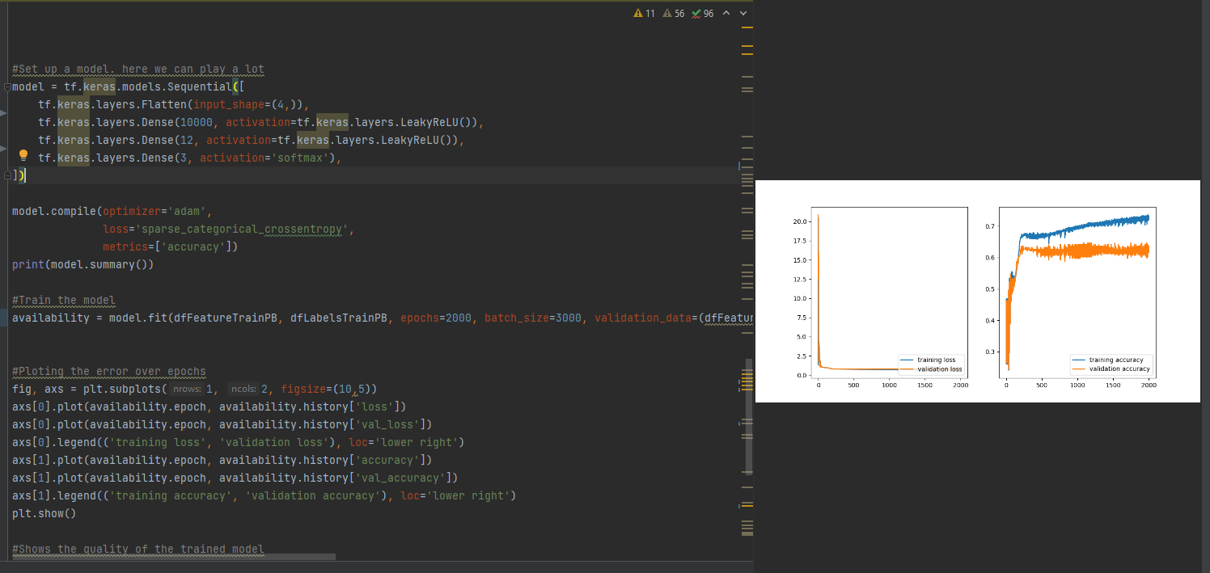

Slide 36
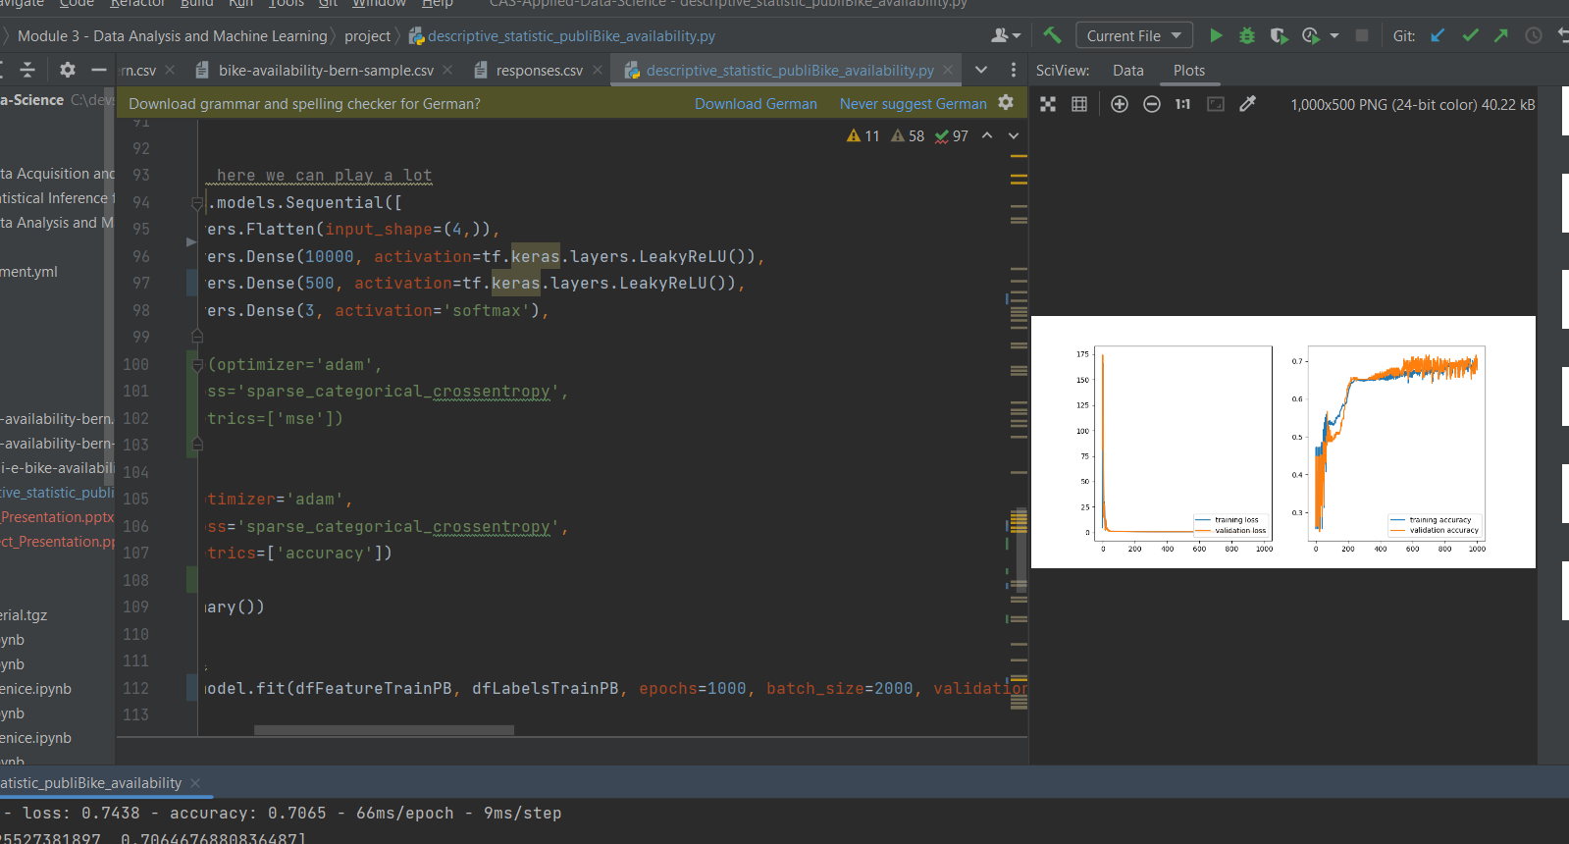
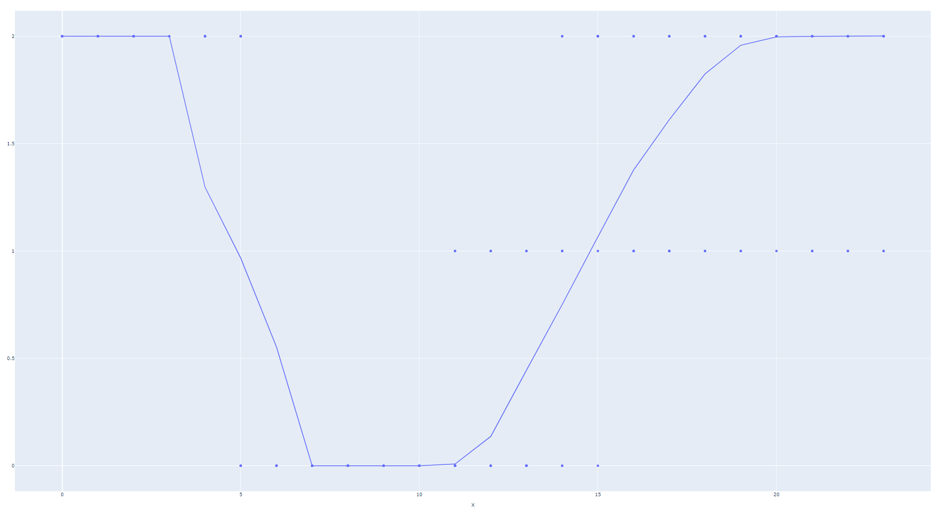

Slide 37
